Slide 1
Rescuing the American Food System
Jason Young
Yale University

Slide 2
Question: What is a food system?

Slide 3
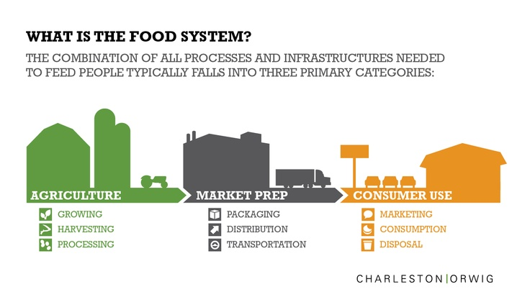
What is a food system?
“A food system includes all processes and infrastructure involved in feeding a population: growing, harvesting, processing, packaging, transporting, marketing, consumption, and disposal of food and food-related items.” - Wikipedia

Slide 4
What is wrong with our food system?
Over 30% of adults in the US are obese and over 60% overweight
associated with negative health consequences, including increased morbidity, mortality, cardiovascular disease, hypertension, and cancer
levels of obesity and overweight are increasing for all ethnic groups and ages, in children and adults
international concern
Notes:
According to the National Heart, Lung, and Blood Institute (NHLBI), overweight and obese individuals are those possessing excess body fat. While overweight patients have a Body Mass Index (BMI) ranging between 25.0 and 29.9, obese individuals have Body Mass Indices exceeding 30.0 . This excess in body fat has been associated with negative health consequences, including increased morbidity, mortality, cardiovascular disease, hypertension, and cancer, among others, and has been known to significantly increase risk factors for these chronic diseases [1]. Today, the National Center for Health Statistics (NCHS) estimates that over 30% of adults in the US are obese and over 60% overweight [1]. Statistics indicate that levels of obesity and overweight are increasing for all ethnic groups and ages, with increases in overweight and obesity in children paralleling trends for adults [1]. Indeed, this national health concern is becoming an increasingly prevalent international crisis, as many countries in the rest of the world, especially developing countries, are experiencing high rates of increasing overweight and obesity [2].

Slide 5
What is wrong with our food system?
Jamie Oliver
Celebrity chef, restaurateur, healthy
eating advocate
video (food system)
video (schools)
Michael Pollan
Food author, journalist
Omnivore’s Dilemma
video
Notes:
Omnivore’s dilemma:
Pollan follows each of the food chains that sustain us; industrial food, organic food, and food we forage ourselves; from the source to a final meal, and in the process writes a critique of theAmerican way of eating.

Slide 6
Discussion: What is your reaction?

Slide 7
Why is our food system broken?
Problems in the food landscape
Ex. supermarket
Big business
Fast food
Government Policy
Subsidies
Cultural changes
Globalizing world
Culture of cooking

Slide 8
Problems in the food landscape
Food deserts
Mostly processed foods
Few fruits and vegetables (of poor quality)
High prices for fruits and vegetables
Mostly in poor areas
Vicious cycle
Doubly bad: obesity prevalence inversely correlated with income
Notes:
“Area (in the United States) with limited access to affordable and nutritious food, particularly such an area composed of predominantly lower income neighborhoods and communities”
--2008 Farm Bill (Title VI, Sec. 7527)

Slide 9
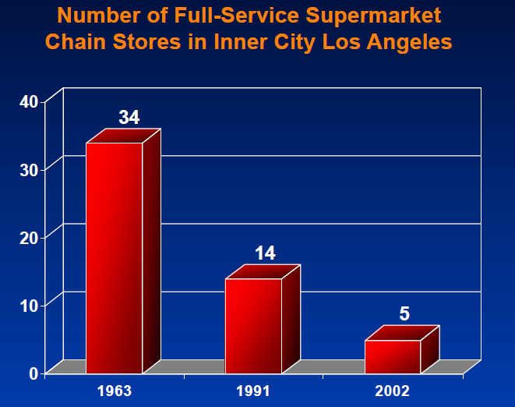
Notes:
Taken from Kelly Brownell lecture for PSYC 123 at Yale University, Spring 2013

Slide 10
Big business
Cause related marketing
Corporate donations for a social cause linked to consumer purchasing (~$1 billion)
Issue misinterpretation
More generally, power of marketing
By 18 years old, you will have:
Watched 82,000 food ads on TV
95% for unhealthy food
Product placement, social media, school, celebrities, games, etc.
Notes:
Images taken from Kelly Brownell lecture for PSYC 123 at Yale University, Spring 2013
Issue misrepresentation:
For example: Pizza company using CRM for breast cancer
Women’s deaths
1 in 31 due to breast cancer
1 in 3 due to heart disease

Slide 11
Notes:
Taken from Kelly Brownell lecture for PSYC 123 at Yale University, Spring 2013

Slide 12
Government Policy
Subsidies to corn and soy production
Lower prices, excess production
Must be sold!
Relative increase in prices of fruit and vegetables

Slide 13
Notes:
Taken from Kelly Brownell lecture for PSYC 123 at Yale University, Spring 2013

Slide 14
Notes:
Taken from Kelly Brownell lecture for PSYC 123 at Yale University, Spring 2013

Slide 15
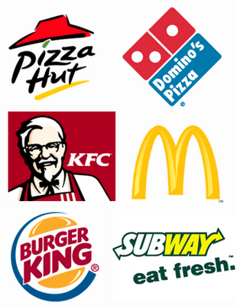
Cultural changes
Globalization
Losing our tradition of cooking
Notes:
Images taken from Kelly Brownell lecture for PSYC 123 at Yale University, Spring 2013

Slide 16
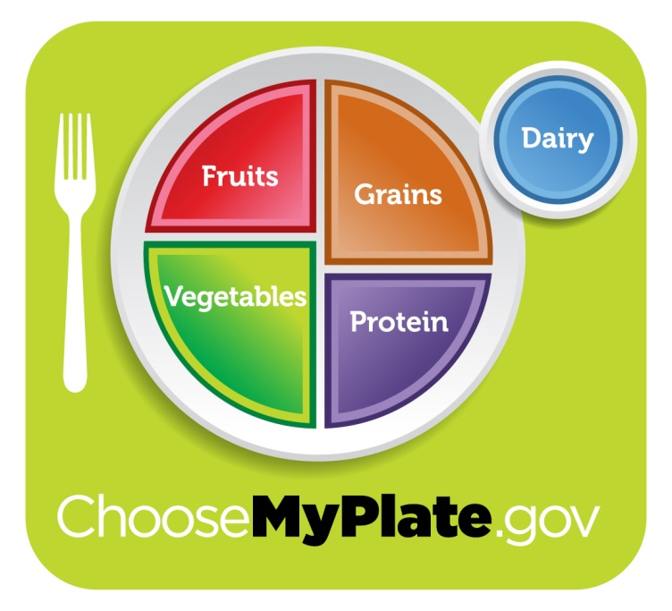
What can we do?
Exercise
Michelle Obama – Let’s Move Campaign
Eat Right
and…..

Slide 17
What can we do?
Cook!
Connect, learn, and take charge!

Slide 18
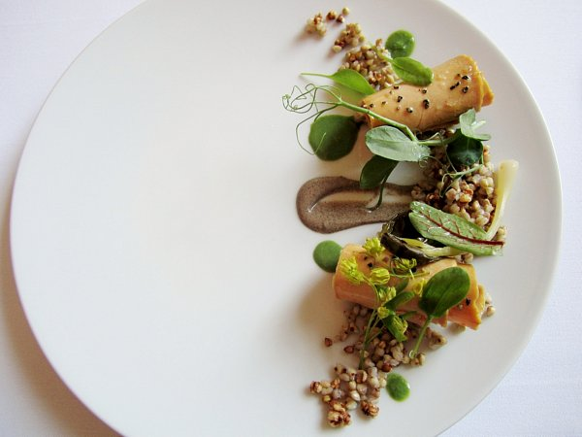

Slide 22
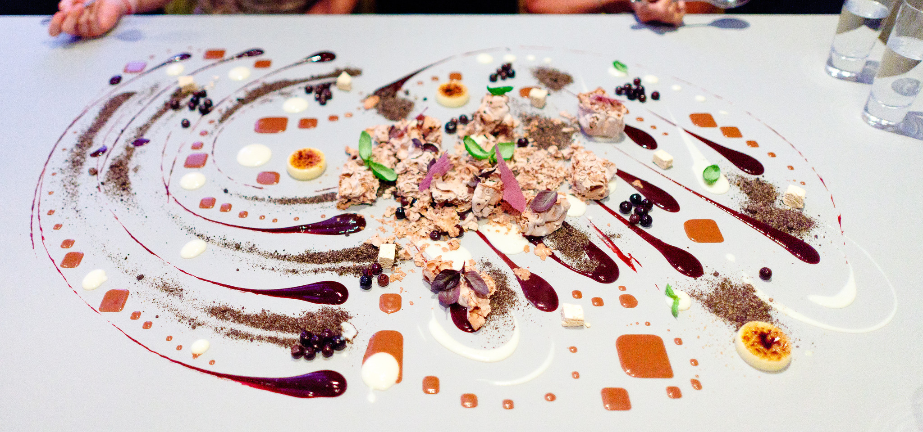

Slide 23
In Summary
A food system is all that goes into the feeding of a population
Ours is a broken one
Problems with the food landscape
Big Business
Government Policy
Cultural Changes
But we can fix it!
Healthy eating
Exercise
Cooking!

Slide 24
Questions?

Slide 25
Suggested Further Reading and Information
Jamie Oliver’s TED talk:
https://www.youtube.com/watch?v=jIwrV5e6fMY
Michael Pollan’s Omnivore’s Dilemma
http://michaelpollan.com/books/the-omnivores-dilemma/
How to cook?
Youtube.com!
Easy Recipes:
http://allrecipes.com/recipes/everyday-cooking/quick-and-easy/
Michelle Obama’s Let’s Move Campaign:
http://www.letsmove.gov/

Slide 26
Sources:
http://www.barlowflowerfarm.com/wp-content/uploads/2012/02/Barlows_Vegetables_1.jpg
https://www.youtube.com/watch?v=jIwrV5e6fMY
http://youtu.be/-T_EAoYE5aw
http://michaelpollan.com/wordpress/wp-content/uploads/2013/04/Michael-Pollan-FranCollinPhoto-sml.jpg
http://en.wikipedia.org/wiki/Jamie_Oliver
http://postmediaprovince.files.wordpress.com/2012/10/noma.jpg
http://3.bp.blogspot.com/-aDC1DSxDjPs/T5cLRM-UO1I/AAAAAAAAH7U/u59SMcM4Ql4/s1600/Eleven+Madison+Park+4-19-12+%252820%2529.JPG
http://www.saveur.com/sites/saveur.com/files/images/2011-10/7-SAV142-EdibleArt01-400x549.jpg
Lectures from Kelly Brownell, PSYC123, Spring 2013, Yale University.
Wyatt, S. B. (2006). Overweight and obesity: Prevalence, consequences, and causes of a growing public health problem. The American Journal of the Medical Sciences, 331(4), 166. doi: 10.1097/00000441-200604000-00002
Berthoud, H. (2012). The neurobiology of food intake in an obesogenic environment. Proceedings of the Nutrition Society, 71(04), 478. doi: 10.1017/S0029665112000602
http://www.famouslogos.org/wp-content/uploads/2009/04/fastfoodlogos.png
http://letsuber.com/wp-content/uploads/2013/10/Alinea.jpg
http://www.eataduckimust.com/wp-content/uploads/2012/01/EADIM-Eleven-Madison-Cookbook-Lobster-Fennel-Orange-Persimmon-02.jpg
http://upload.wikimedia.org/wikipedia/commons/5/50/USDA_MyPlate_green.jpg
http://powayusdnutrition.com/images/letsmove1.jpg

